Slide 1
Evaluating and Classifying Water Quality using Machine Learning Technique
DOMAIN: MACHINE LEARNING
BATCH A8
ANANDHA LAKSHMI P [211418104019]
GOWTHAMI D[211418104071]
HARITHA R[211418104080]
GUIDE: Mrs.D.JENNIFER, M.E.,

Slide 2
INTRODUCTION
Water pollution can be described as one of the most dangerous threats that the humanity ever faced. It causes damage to animals, crops, forests etc.
To prevent this problem we have to predict water quality from pollutants using machine learning techniques. Hence, water quality evaluation and prediction has become an important research area.
The aim is to investigate machine learning based techniques for water quality forecasting by predicting results in best accuracy.
Based on certain features like aluminium, ammonia, arsenic, barium, cadmium, chloromine, chromium, copper, chloride, bacteria, virus, lead, nitrate, nitrite, mercury, perchlorate, radium, selenium, silver, uranium.
Our analysis provides a comprehensive guide to sensitivity analysis of model parameters with regard to performance in prediction of water quality by accuracy calculation.
To propose a machine learning-based method to accurately predict the Water Quality by predicting results in the form of best accuracy from comparing supervised classification machine learning algorithms. .
Additionally, to compare and discuss the performance of various machine learning algorithms from the given water supply department dataset with evaluation classification report,
The effectiveness of the proposed machine learning algorithm technique is obtained with precision, Recall and F1 Score.

Slide 3
LITERATURE SURVEY
TITLE AND AUTHORS | ALGORITHM | METHODOLOGY
Comparison of Water Quality Classification Models using Machine Learning Neha Radhakrishnan; Anju S Pillai (2021) | SVM, Decision Tree and Naïve Bay | Parameters used are pH, DO, BOD, and electrical conductivity. The decision tree algorithm was found to be good.
Water quality prediction and classification based on principal component regression Md.Saikat islam khan(2021) | Gradient Boosting Regression, Multiple Linear Regression, Support Vector Regression | 9 parameter are used:PH,DO,TDS,Chloride,COD, Turbidity,Alkalinity Support Vector Regression produce high accuracy
Prediction of groundwater quality indices using Machine Learning algorithms Hemant Raheja, Arun Goel, Mahesh Pal(2021) | Gradient Boosting Model, DNN, and XGBoost. | 12 parameters used. To calculate water quality 2 indices are used.Entropy water quality index,Water quality indexAs the result of 2 indices EWQI Is efficient.DNN-high accuracy.
Research on water quality prediction method based on AE-LSTMHuiqing Zhang, Kemei Jin (2021) | AE-LSTM (Auto encoder Long and short term memory) And LSTM | predicting the concentration of total phosphorus(TP) and total nitrogen (TN).AE-LSTM has better accuracy.

Slide 4
Water quality analysis in a lake using deep learning methodology P.Senthil Kumar, Prasannamedha G, Soumya K (2020) | Algorithm used are Artificial Neural Network, Recurrent Neural Network, and Long Short Term Memory | PH,TDS,COD,Nitrate,Iron, Sodium,Phosphate,Turbidity, chloride are parameters. LSTM has highest accuracy of 94%
Predicting Water Quality Parameters Using Machine Learning Nikhil M Ragi; Ravishankar Holla; G Manju(2020) | Artificial Neural network is used. -Levenberg-Marquardt algorithm. | It predicts unknown parameters like Alkalinity, Chloride, Sulphate values using known parameters such as pH, Electrical Conductivity, TDS etc. using Levenberg-Marquardt algorithm. Results gave accuracy of 83.94%, 87.9%, 81.736%, 79.48% in predicting chloride, total-hardness, sulphate, total alkalinity respectively
Water Quality Prediction Using Artificial Intelligence Algorithm Theyazn H. H Aldhyani, Mohammed Al-Yaari, Hasan Alkahtani and Mashael Maashi (2020) | WQI-prediction-nonlinear autoregressive neural network (NARNET) and long short-term memory (LSTM)WQC forecasting- machine learning algorithms, namely, support vector machine (SVM), K-nearest neighbor (K-NN), and Naive Bayes | parameters - dissolved oxygen (DO), pH, conductivity, biological oxygen demand (BOD), nitrate, fecal coliform, and total coliform are used.Svm and narnet has maximum accuracy

Slide 5
Ground Water Quality Predictionusing MachineLearning Algorithms S.Vijay & Dr.K.Kamaraj (2019) | C5.0, Naïve Bayes and Random forest as learner for water quality prediction | Parameters used:as PH, EC, Chloride, Sulphate, Nitrate, Carbonate, Bicarbonate, metal ions. Naïve Bayes has best accuracy.
Predictive Analysis of Water Quality Parameters using Deep Learning Archana Solanki, Himanshu Agrawal, Kanchan Khare (2019) | Algorithms are stacked denoising autoencoder, deep belief network, linear regression,multilayer perception | The comparison of results show that robustness can be achieve by denoising autoencoder and deep belief network and also successfully handle the variability in the data.. Parameters used are ph,dissolved oxgen,turbidity.
Water Quality Analysis and Prediction using MachineLearning Algorithms Mr.M.Anbuchezhian, Dr.R.Venkataraman, | Algorithms:Navie Bayes(NB), Decision Tree(DT), K-Nearest Neighbor (KNN), Support Vector Machine(SVM), and Random Forest(RF) | The parameters used to predict quality are temp, dissolved oxygen (DO) (% sat), pH, conductivity, Biochemical oxygen demand (BOD), nitrates (NO3), faecal and total coli forms (TC). Random forest has highest accuracy.

Slide 6
PROBLEM DEFINITION
Water pollution is the contamination of water bodies that occur when pollutant are indirectly or directly discharged into water bodies without adequate treatment which affects the ecosystem and human life and is an issue nowadays.
Therefore, it is very important to suggest new approaches to analyze and predict the water quality (WQ).
The aim is to Develop highly efficient machine learning models to predict the water quality based on machine learning algorithms.
Applying some machine learning models, namely, Support Vector Machine (SVM), Logistic Regression , Decision Tree,Random Forest algorithms, for the prediction of water quality classification (WQC).

Slide 7
DEVOLOPMENT ENVIRONMENT
1. Software Requirements:
Operating System : Windows 10
Tool : Anaconda with Jupyter Notebook
2. Hardware requirements:
Processor : intel i5
Hard disk : 500 GB
RAM : 8 GB

Slide 8
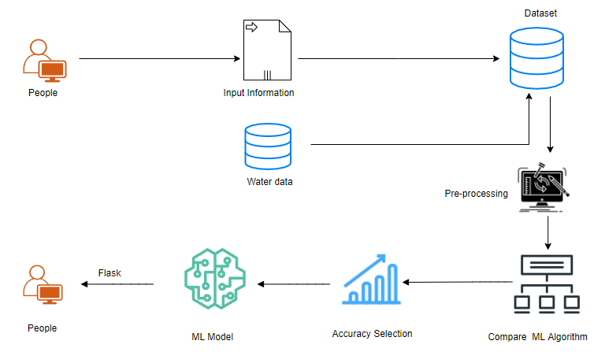
SYSTEM ARCHITECTURE
Aluminium ,ammonia,bacteria,
virus,..(20 parameters)
Decision Tree 95% Svm,DT,Rf,LR

Slide 9
.
SYSTEM DESIGN-
DATA FLOW DIAGRAM
.
Source Data
Data Processing and Cleaning
Training Dataset
Testing Dataset
Classification ML Algorithms
Best Model by Accuracy
Finding Water quality

Slide 10
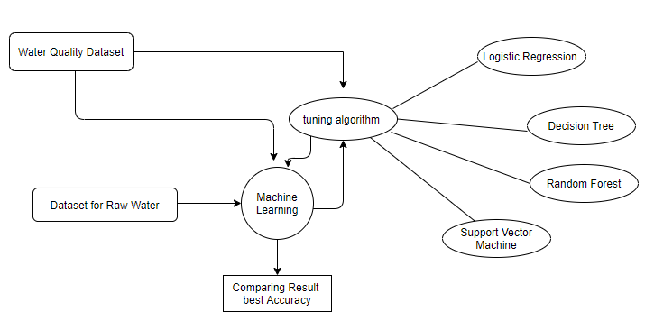
ER DIAGRAM

Slide 11
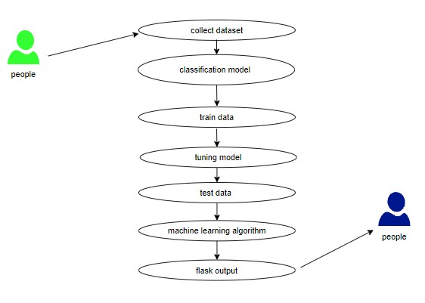
UML DIAGRAMS -USE CASE DIAGEAM

Slide 12
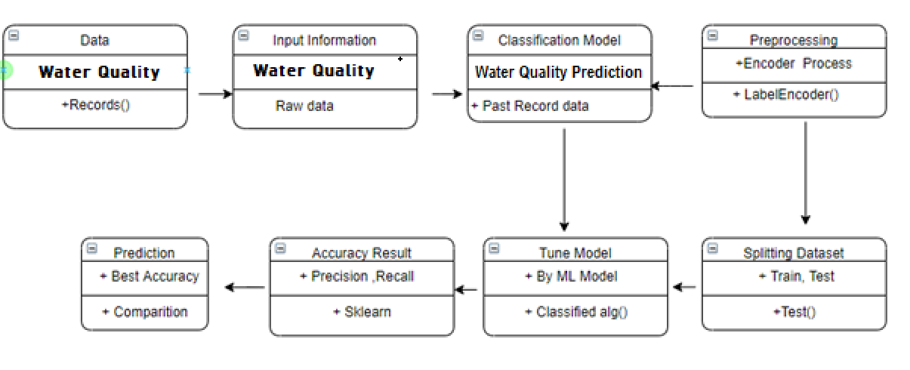
CLASS DIAGRAM

Slide 13
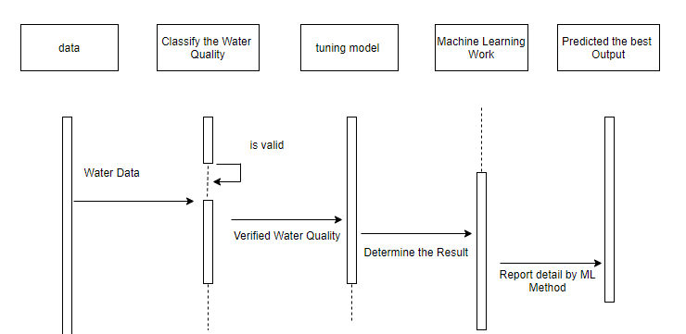
SEQUENCE DIAGRAM

Slide 14
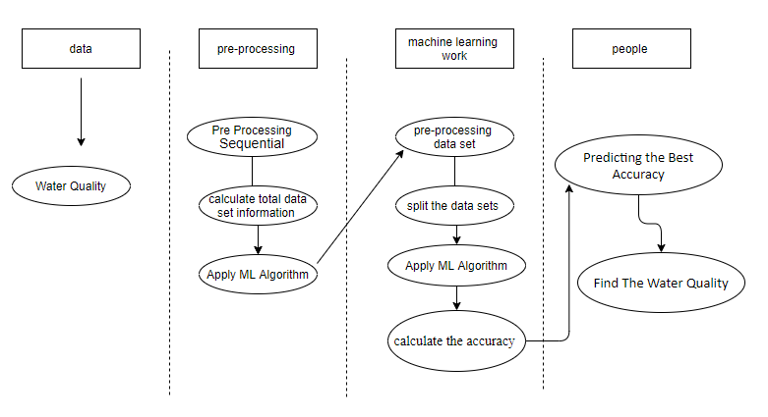
ACTIVITY DIAGRAM

Slide 15
List of Modules:
Data Preprocessing Technique.
Exploratory Data analysis and visualization.
Comparing Algorithm with prediction in the form of best accuracy result.
Deployment using Flask(predicting result by accuracy).

Slide 16
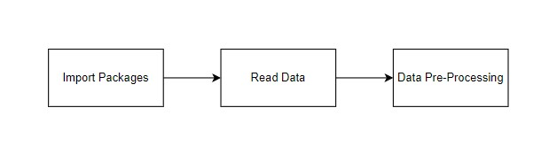
MODULES DESCRIPTION
Data Pre-processing
Finding duplicate values , and it does the process of removing duplicate values, it focus on probably the biggest data cleaning task, missing values and it able to more quickly clean data, detect missing values and do some basic imputation and detailed statistical approach for dealing with missing data.
Exploratory Data Analysis and data visualisation
Data visualisation provides tools for qualitative understanding which is helpful for understanding dataset , exploring dataset and identifying outliers pattern corrupt data etc. it is used to express the key relationship in charts plots .
Expressing the data in visual form makes it more understandable.

Slide 17
.
Data collection
The data set collected for predicting the given data is split into Training set and Test set. Generally, 7:3 ratios are applied to split the Training set and Test set. The Data Model which was created using Random Forest, logistic, Decision tree algorithms and Support vector classifier (SVC) are applied on the Training set and based on the test result accuracy, Test set prediction is done.
Comparing Algorithm with prediction in the form of best accuracy result
It is important to compare the performance of multiple different machine learning algorithms consistently which leads to creating a test harness to compare multiple different machine learning algorithms in Python
4 different algorithms are compared:
Logistic Regression
Decision Tree
Random Forest
Support Vector Machine

Slide 18
.
Result:
Predicting result by accuracy
Precision-The Proportion of the total number of predictions that is correct, otherwise overall how often the model predicts correctly(TP/(TP+FP))
Recall - The proportion of positive observed values correctly predicted. (TP / (TP + FN))
Accuracy is the most intuitive performance measure and it is simply a ratio of correctly predicted observation to the total observations.(TP+TN/(TP+TN+FP+FN))
The result of the model with high accuracy is chosen as the final result.
Decision Tree has the highest accuracy of 95%.

Slide 19
PERFORMANCE ANALYSIS
Confusion matrix-LR: Confusion matrix-RF
True Positive : 73 True Positive :2109
True Negative : 201 True Negative :16
False Positive : 35 False Positive :93
False Negative : 2090 False Negative :181
Confusion matrix-DT: Confusion matrix-DT
True Positive : 225 True Positive :0
True Negative : 49 True Negative: 274
False Positive : 70 False Positive:0
False Negative : 2055 False Negative:2125

Slide 20
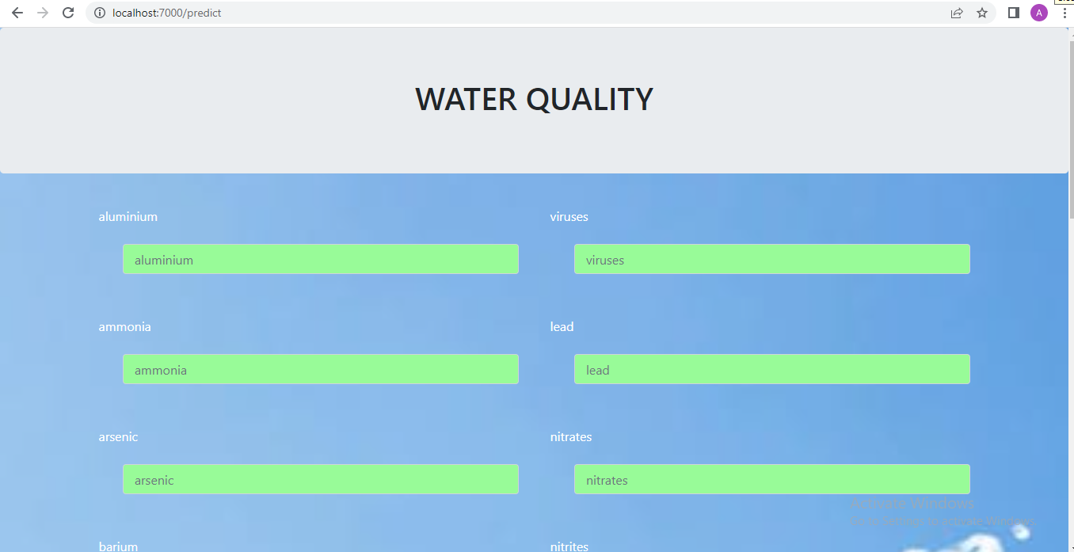
OUTPUT SCREENSHOT

Slide 21
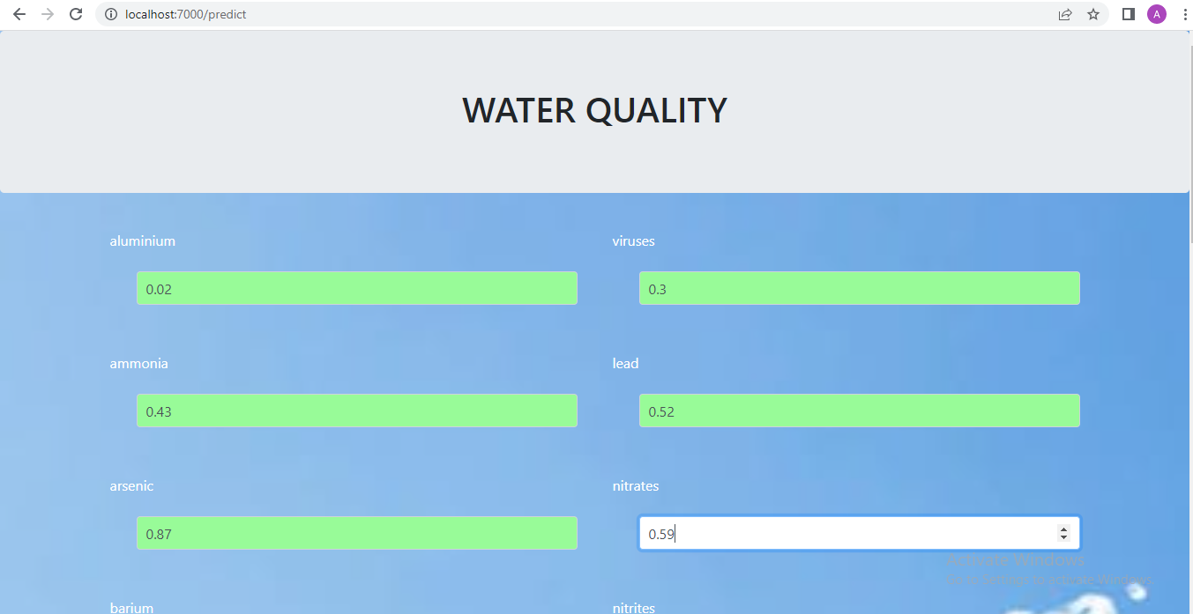
ENTERING VALUES OF PARAMETERS

Slide 22
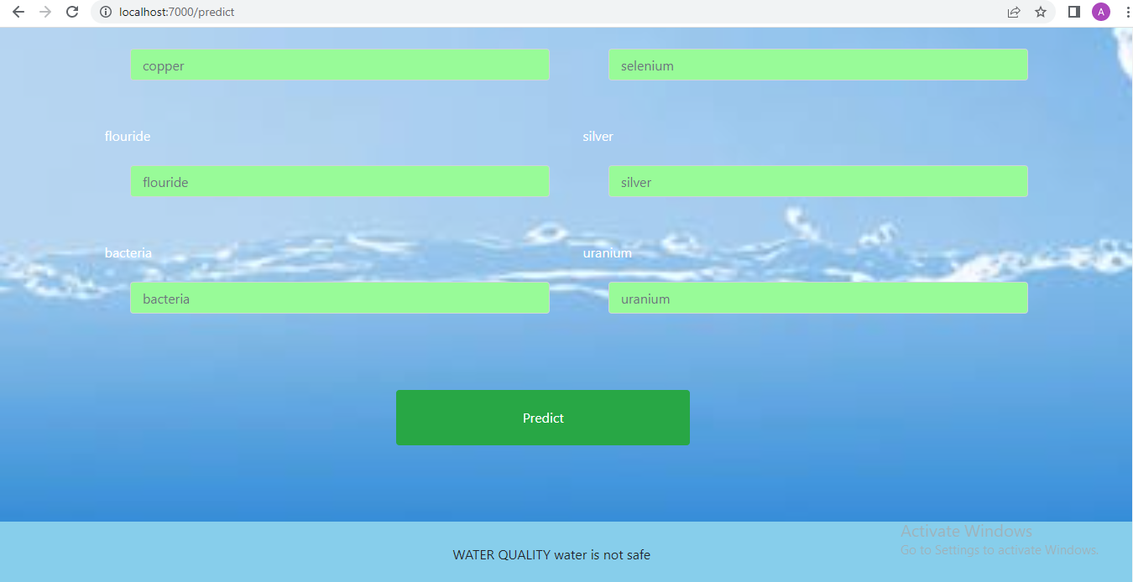
PREDICTING WATER QUALITY

Slide 23
CONCLUSION
The proposed model was used to predict the water quality. For this purpose the dataset mentioned earlier was used to evaluate the model performance to find out the best one, comparisons with RF,LR,SVC,DT were exhibited. The dataset was split into 70% and 30%for training and testing purposes respectively. For the results performance of 4 algorithms were compared in which Decision Tree has attained the highest accuracy of 95% when compared to 3 other algorithms. Finally the system is deployed as a web application using flask framework. This system predicts the water quality status as safe or unsafe for drinking.

Slide 24
REFERENCES
[1]Neha Radhakrishnan; Anju S Pillai,Year 2020, “Comparison of Water Quality Classification Models using Machine Learning”, Fifth International Conference on Communication and Electronics Systems ,page 1183-1188
[2]Md.Saikat islam khan, Year 2021,”Water quality prediction and classification based on principal component regression” , Journal of King Saud University-Computer and Information Science, page 1-9
[3]Hemant Raheja,Arun Goel, Mahesh Pal, Year 2021,”Prediction of groundwater quality indices using Machine Learning algorithms”, International journal of machine learning and computing,Volume17 no , page 337-351
[4]Huiqing Zhang, Kemei Jin,Year 2021,”Research on water quality prediction method based on AE-LSTM”, 5th International Conference on Automation, Control and Robotics Engineering, page 602-606
[5]P.Senthil kumar, Prasannamedha G, Soumya k,Year 2020, “Water quality analysis in a lake using deep learning methodology”, International journal of environmental analytical chemistry, page 1-16
[6]Nikhil M Ragi; Ravishankar Holla; G Manju ,Yaer 2020,”Predicting Water Quality Parameters Using Machine Learning”, 4th International Conference on Recent Trends on Electronics, Information, Communication Technology (RTEICT)
[7]Theyazn H. H Aldhyani, Mohammed Al-Yaari, Hasan Alkahtani and Mashael Maashi ,Year 2020,”Water Quality Prediction Using Artificial Intelligence Algorithm”, International journal of applied bionics and biomechanics ,page 1-12
[8] S.Vijay & Dr.K.Kamaraj,Year 2019, “Ground Water Quality Prediction using Machine Learning Algorithms”, International Journal of Research and Analytical Reviews, Volume 6 no 1,page 743x-749x
[9] Archana Solanki, Himanshu Agrawal, Kanchan Khare, Year 2019 ,”Predictive Analysis of Water Quality Parameters using Deep Learning”, International journal of computer application, Volume 125 no 9, page 29-34
[10] Mr.M.Anbuchezhian, Dr.R.Venkataraman, Mrs.V.Kumuthavalli,Year 2018,”Water Quality Analysis and Prediction using Machine Learning Algorithms”, International journal of emerging technologies and innovative Research, Volume 5 no 11,page 455-462
[11] Libu Manjakkal, Srinjoy Mitra , Yvan R. Petillot , Member, IEEE, Jamie Shutler , E. Marian Scott,Magnus Willander, and Ravinder Dahiya,year 2021, Connected Sensors, Innovative Sensor Deployment,and Intelligent Data Analysis for Online Water Quality Monitoring, IEEE INTERNET OF THINGS JOURNAL, VOL. 8, NO. 18,

